Slide 1
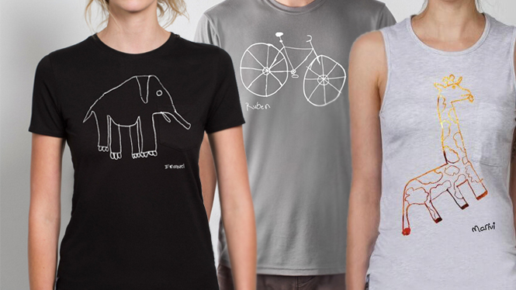

TEAM TERRY

Slide 2

Requested
Deliverables
New Market Opportunities
New Marketing Strategy
New Product Ideas

Slide 3
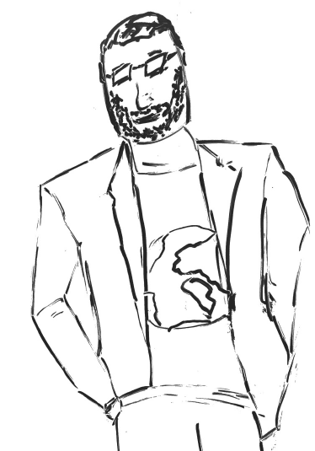
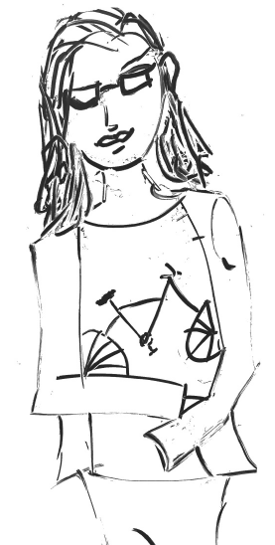
New Market Opportunities

Slide 4



Supporting Research
Consumer Research
Generation X: internet users aged 40-51
Prime earning years
7/10 have purchased clothing online
Men and women have different self-perceptions
Nearly 50% have children who are under 18
Cynical vs. realistic
TV still relevant for this age group - Shark Tank
Notes:
Gen x
About 50 MM Americans
Makes up about 15.2% of the population
prime earning years
Incentives for customers to share on social media
Motivate customers through making an impact/sharing your cause on social media
Men and women have different self- perceptions
Moderate support for social change
Women more accepting of change
Parents more engaged in ads
Urban dwellers more concerned with trends
Their voice has been drowned out by millennials and they have a desire to be heard

Slide 5
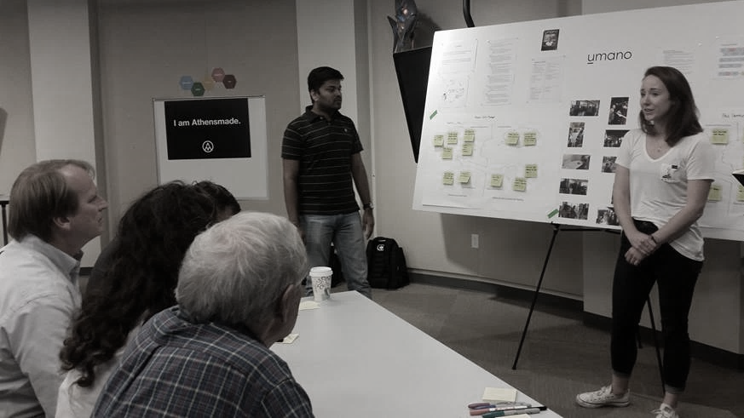
Supporting Research
Innovation Summit
Potential for dual-gift giving?
Marketing gimmick vs meaningful social enterprise
“40-50 year old's are a natural fit”

Slide 6
Concept
Who Are They?
Traits
Interests
College-educated
Discretionary income
Desire meaningful relationships w/ brands
Willing to advocate on behalf of brands and products they believe in
Live in urban areas
Middle/ upper management roles
Social causes
Fair trade
Shop at places like Whole Foods & Trader Joes
Philanthropy
Art/ museums/ festivals
Foodies
Generally tech-savvy
Connected/Involved
Social-Minded 40-50 yr. old males and females in the U.S.
market size = 7M

Slide 7


Implementation
How to Reach Market
Voice
Humor and realism
Communication around quality
Medium
TV is still applicable to market to this group
Image based platforms – Instagram and Pinterest
Facebook & e-mail
Online review sites
Shopping platform
Responsibility
Brand Manager
Notes:
For parents of this group, create advertising that appeals to the unique sensibility of parents with kids entering young adulthood
For women of this generation specifically

Slide 8

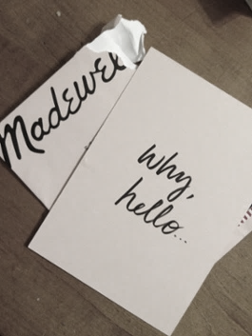

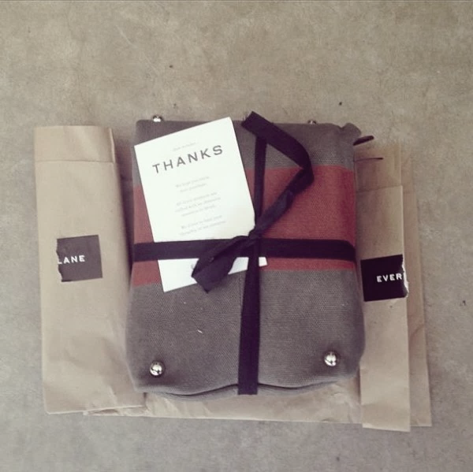
Inspirational Brands
Notes:
Secondary Research
Brand Inspirations - message and culture is easily identifiable
Madewell
Rag & Bone
All Saints
BLK DNM
Vans
Everlane

Slide 9
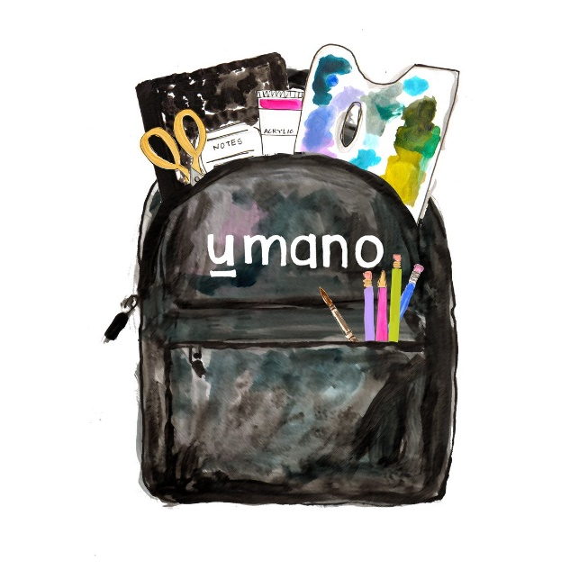
Supporting Research
Critical Success Factors
Let their voice be heard
Be Real
Be Transparent
Focus on the Cause
Keep it brief
Stay consistent

Slide 10
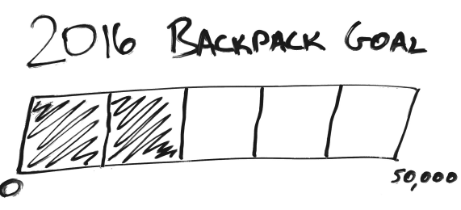
New Marketing Strategy

Slide 11
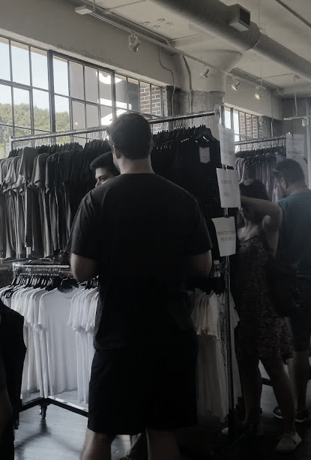
Supporting Research
Analogous Models
Warby Parker
Charity Water
Feed
Fall Sample Sale
Cause of umano was emphasized
Innovation Summit
How can you tell customers about the dollar amount that goes towards kids?
What did giving art supplies do for the kids and the school? Did it increase creativity?

Slide 12
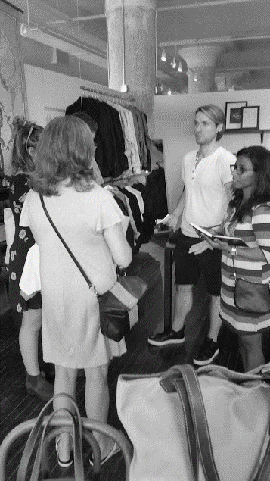
Concept- Marketing Strategy
Clear, concise messaging focused on cause
Goal Meter
Transparency throughout process

Slide 13
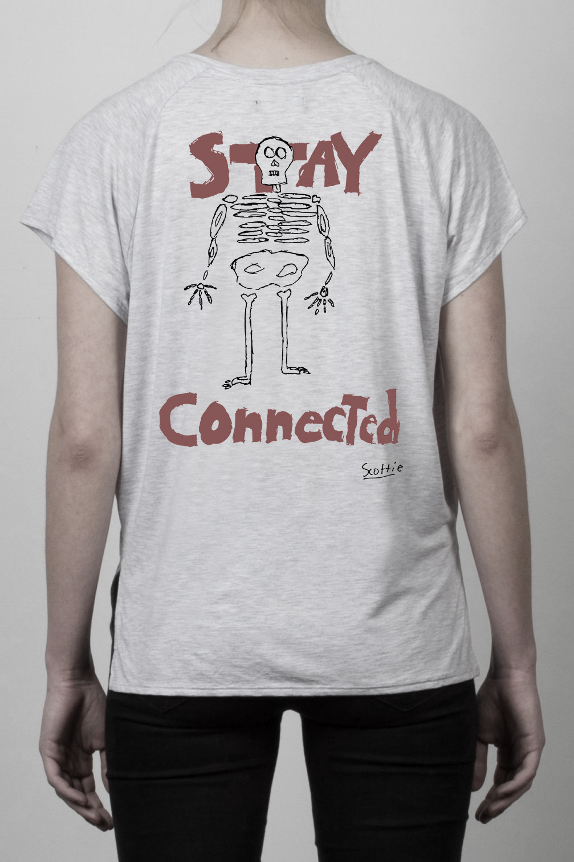
Concept
Communicating a clear, concise message focused on the cause
The charitable giving of umano is the company’s competitive advantage – communicate this
The mission of giving backpacks should be the central focus of the message to consumers
In today’s digital age of overwhelming media sources, brevity is key
Captivate the customer’s attention while communicating the message quickly

Slide 14
Concept
Goal Meter
On the website
More tangible
A sense of urgency
Transparency in the giving
Including the goal meter in an email in a quarterly newsletter format in addition to a blog
In the office
Culture
Physical reminder of company’s goal

Slide 15

Concept
Transparency throughout the company’s processes
Emphasize the supply chain’s sourcing of fair trade elements and where they come from
Illustrate the transparency of the giving
What’s specifically in the backpack
Communicate very clearly that a backpack is given for each shirt purchased
How does the giving translate to art education?
Creating a connection between customer and the kids

Slide 16
Implementation
The implementation of this marketing strategy requires day-to-day management by the social media director and ecommerce director
Goal Meter
Who- Marketing Manager/Ecommerce Manager
What- Incorporation of a goal meter showing the yearly amount of backpacks distributed
Where- Displayed on the website - “our story” page & within umano’s workspace
Newsletter/Blog
Who- Ecommerce Manager/Social Media Manager
What- Quarterly newsletter with the updated goal meter & a blog post describing umano’s recent giving trip(s) for the quarter
Where- Sent via email and updated on the blog

Slide 17
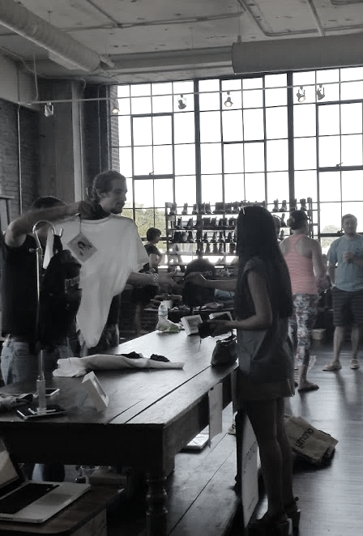
Implementation
Critical Success Factors
Concise and Focused Messaging
Consumer Action

Slide 18
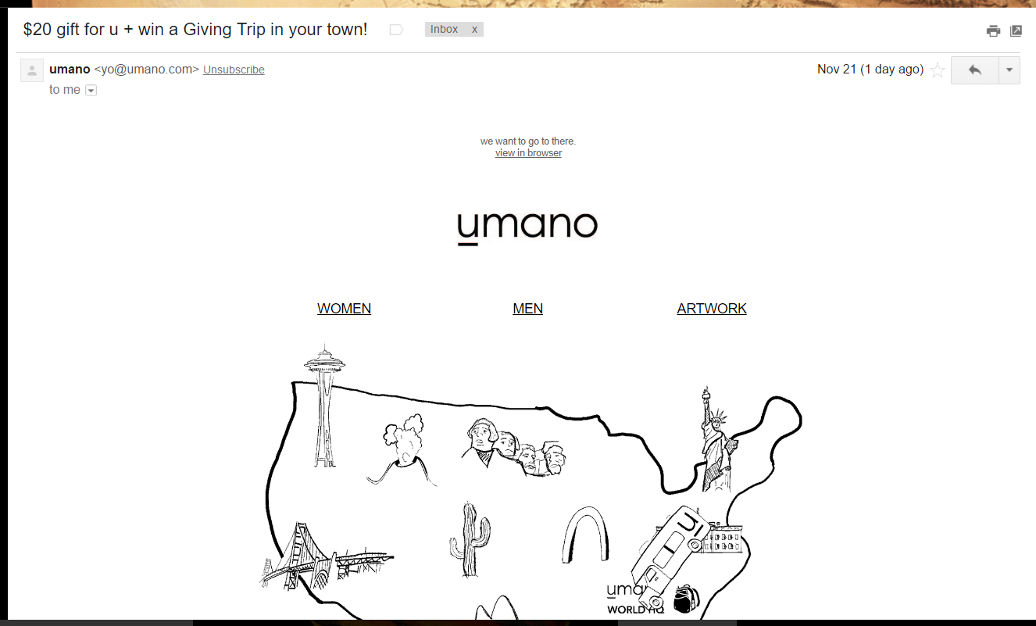
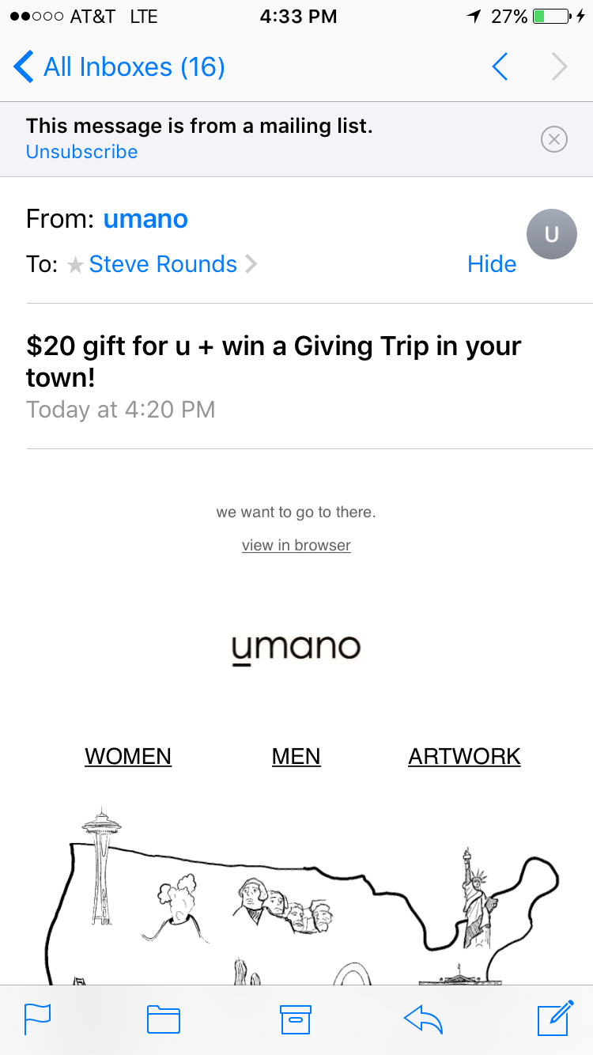
Implementation
E-mail

Slide 19
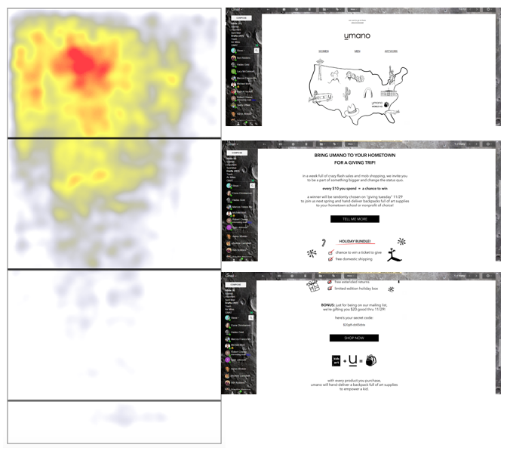
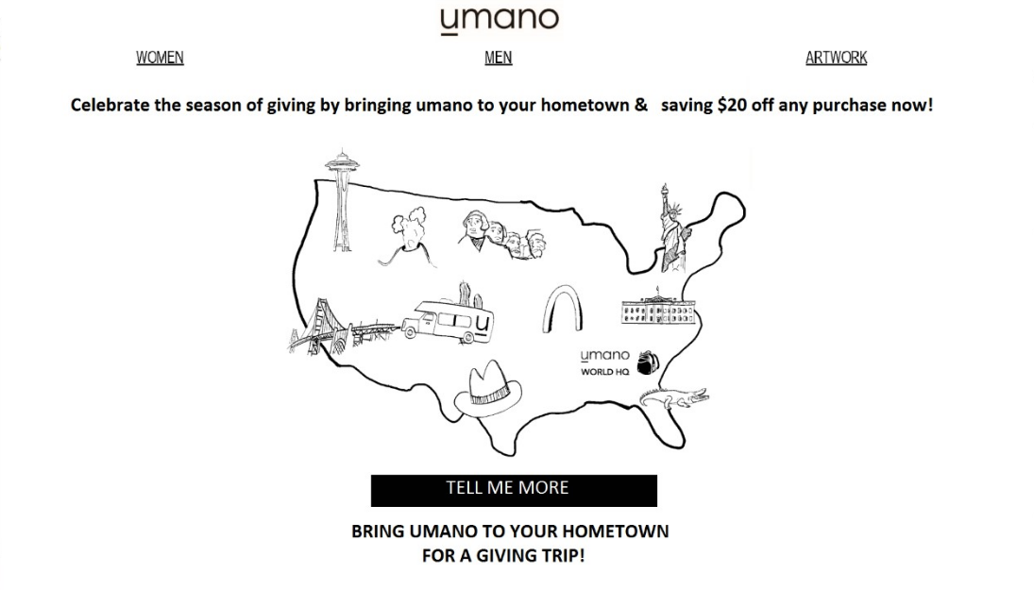
Implementation
E-mail

Slide 20

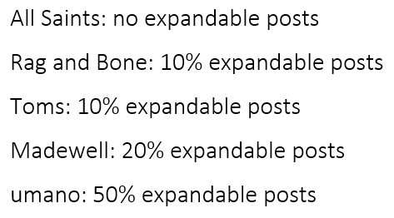
Implementation
Instagram

Slide 21
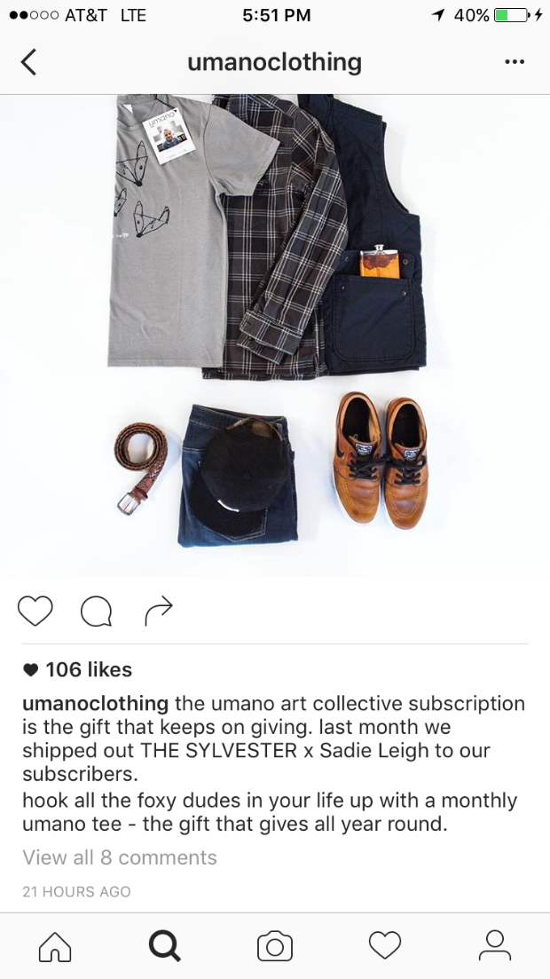

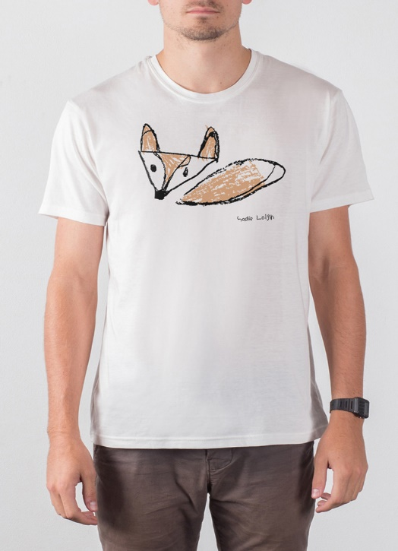
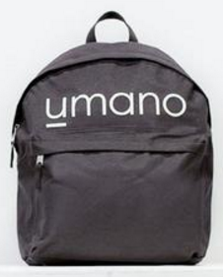
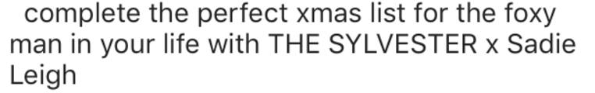
Implementation
Instagram
The more you gift, the more you give #umanoartcollectivesubscription

Slide 22
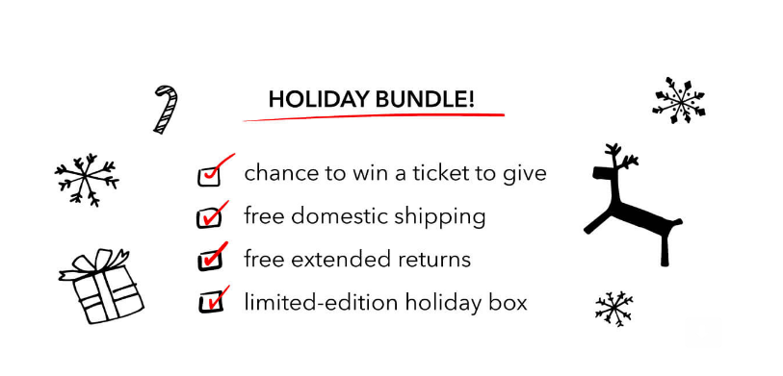
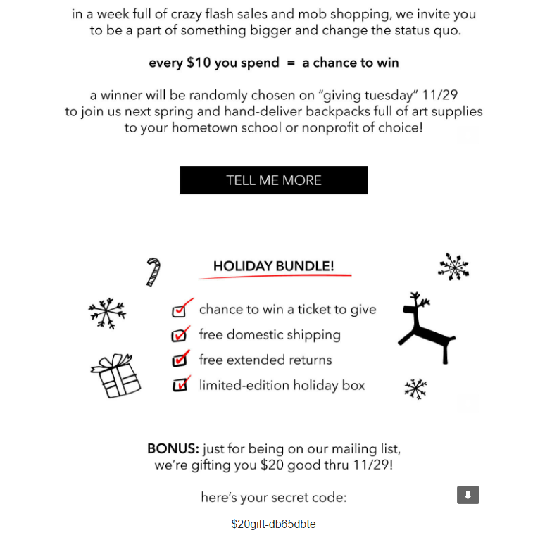
Implementation
Facebook

Slide 23
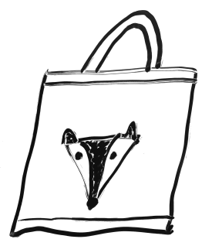
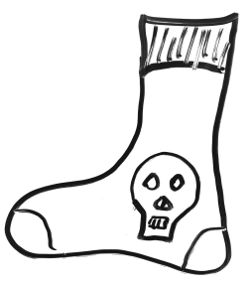
New Product Ideas

Slide 24
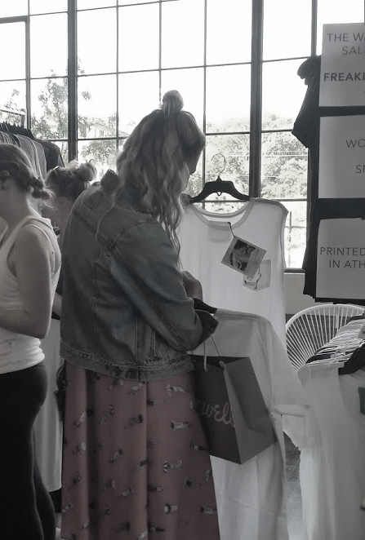
Supporting Research
Survey monkey results
47% - Clothing styles
19.4% - Hats, beanies and scarves
Less expensive products are appealing
More options for men
Fall sample sale
Cause and fabric; a lower price point would improve engagement
More variation in products/ designs
Innovation summit
Respondents approved of team’ suggested items
“Socks make sense but quality need to be on par with tees”
Men wearing formals regularly have only hankies and socks to accessorize

Slide 25
Concept
Suggested Products
Socks
Canvas bags
Scarves/ Pocket square
Headbands and bandanas
Reasons
Variety for customers
Easy to screen-print
Lower price for budget customers- Untapped market
Logical extension for umano as a brand
Increased average order value (AOV)

Slide 26
Implementation
Target Market
Young moms/ Rad dads
40-50-yr-old high socially conscious customers
How to reach market
Instagram and Twitter
Facebook
E-mail
Art festivals, museum gift shops, film festivals
Responsibility
CEO
Sourcing Manager

Slide 27
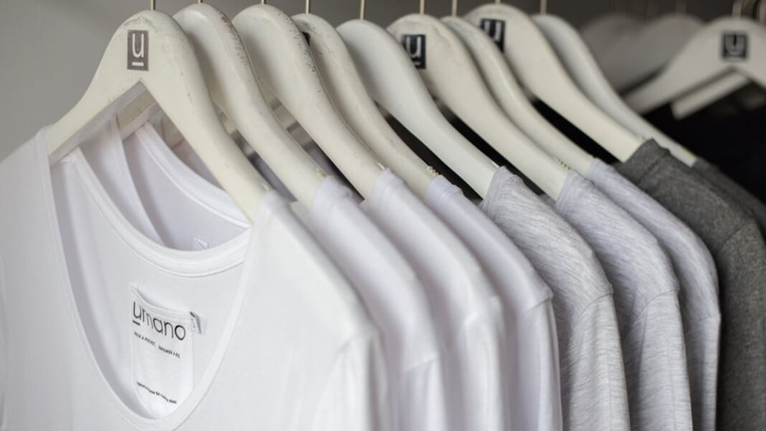
Critical Success Factors
Focus on Consistency
Quality- Maintain quality expectations
Design- Consistent with umano’s original design
Avoid too much variety in new items
Natural Fit
New products should appear as an extension of original products
Should be in line with umano’s culture – hip, cool, lifestyle brand

Slide 28

Q&A

Slide 29





Thank You

